Slide 1

Sidhant Ahluwalia

Slide 2


Agenda
Overview of the dataset
Problem Statement
Literature Review
Data cleaning and preprocessing
Method implementations – MLR, CART, kNN
Analysis
Conclusion

Slide 3
Introduction
Game Background
Source: https://www.kaggle.com/c/pubg-finish-placement-prediction

Slide 4
Overview of the dataset
variables and records in the data
29 Variables : 4.4 million records
Types of variables
28 continuous, 1 categorical

Slide 5
Overview of the dataset (Variables)
DBNOs | killPoints
assists | killStreaks
boosts | kills
damageDealt | longestKill
headshotKills | matchDuration
heals | matchId
id | matchType
killPlace | rankPoints

Slide 6
Overview of the dataset (Variables)
revives | winPoints
rideDistance | groupId
roadKills | numGroups
swimDistance | maxPlace
teamKills | winPlacPerc
vehicleDestroys
walkDistance
weaponsAcquired

Slide 7
Problem statement
The objective of this data mining task is to predict a player’s finishing placement based on the final stats generated at the end of the match.
Output variable: Winplaceperc

Slide 8
literature
Title | Source | Author Name & Year
Individual performance in team-based online games: This article explains about how the individual performance is affected by various factors in the multiplayer online battle arena game which is Legends of the League. | https://www.ncbi.nlm.nih.gov/pmc/articles/PMC6030337/ | Author: Marina del Ray( 5th June, 2018)
Patterns affecting the skills in Halo: How player’s gameplay patterns affect the wining in the game of Halo and making predictions for the same. | https://jeffhuang.com/Final_HaloLearning_CHI13.pdf | Authors: Jeff Huang, Thomas Zimmermann & Charles Harrison(June 2013)
Predicitng Winner in StarCraft Games : This study predicts the winner in two player Star Craft Games using the classification models. | http://ceur-ws.org/Vol-1394/paper_3.pdf | Author: Antonio A. S´anchez-Ruiz ( April 2016)
.

Slide 9
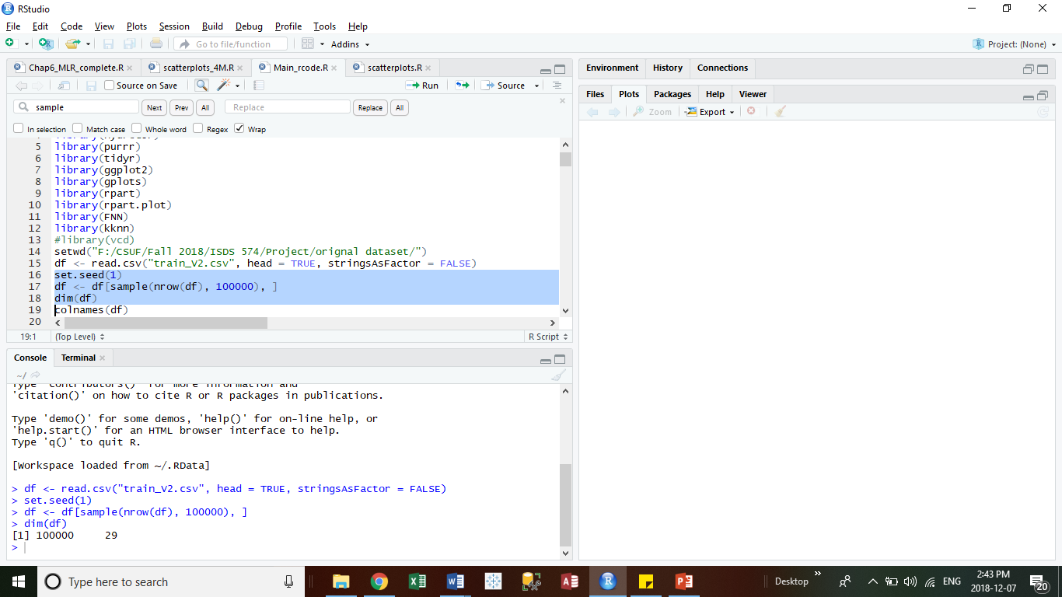
Data Exploration
We had huge data set of 4.4 million rows of data which was difficult to handle. Thus we did the random sampling of 100,000 rows of data

Slide 10
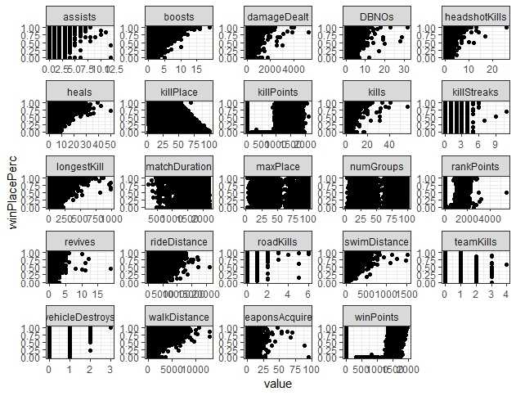
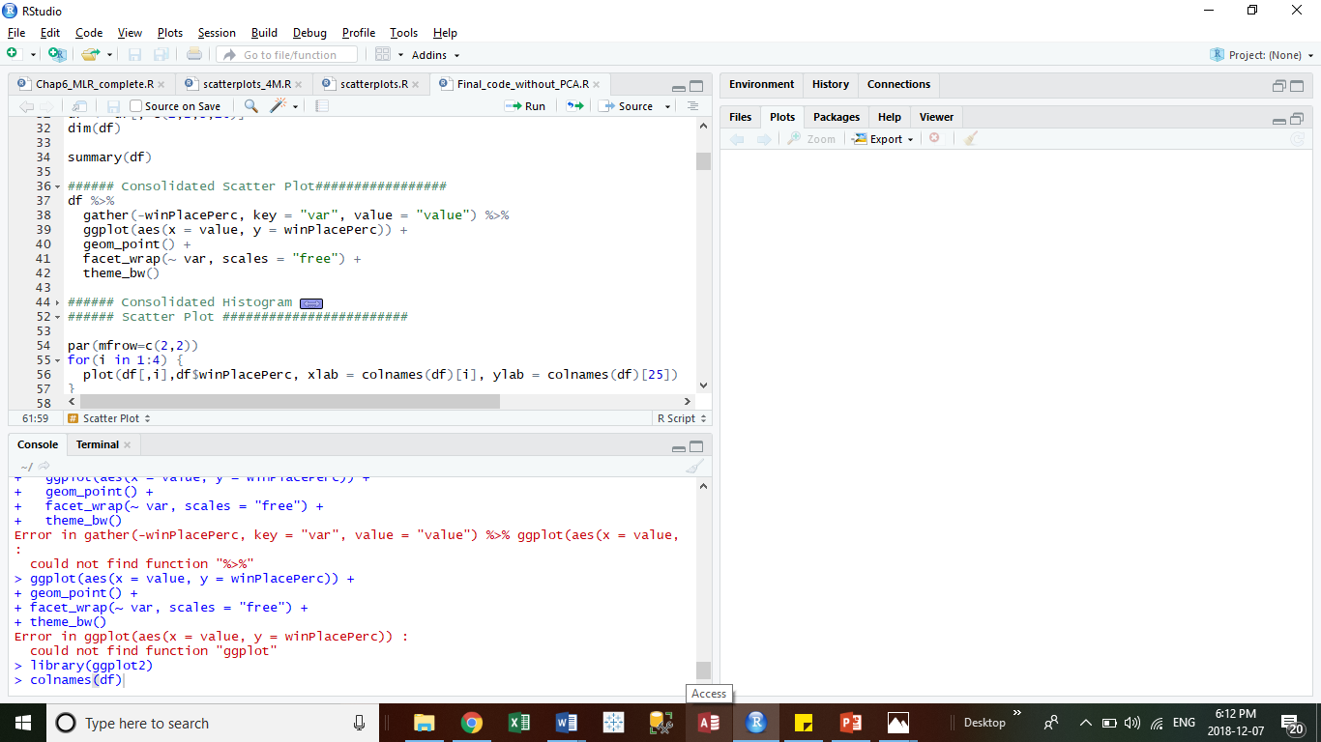
SCATTERPLOTS

Slide 11
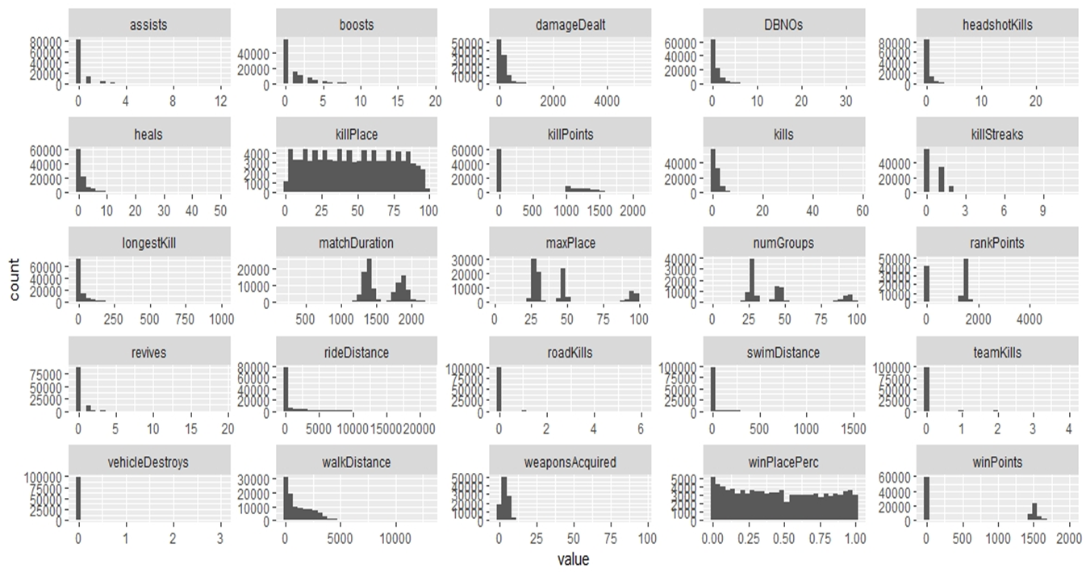
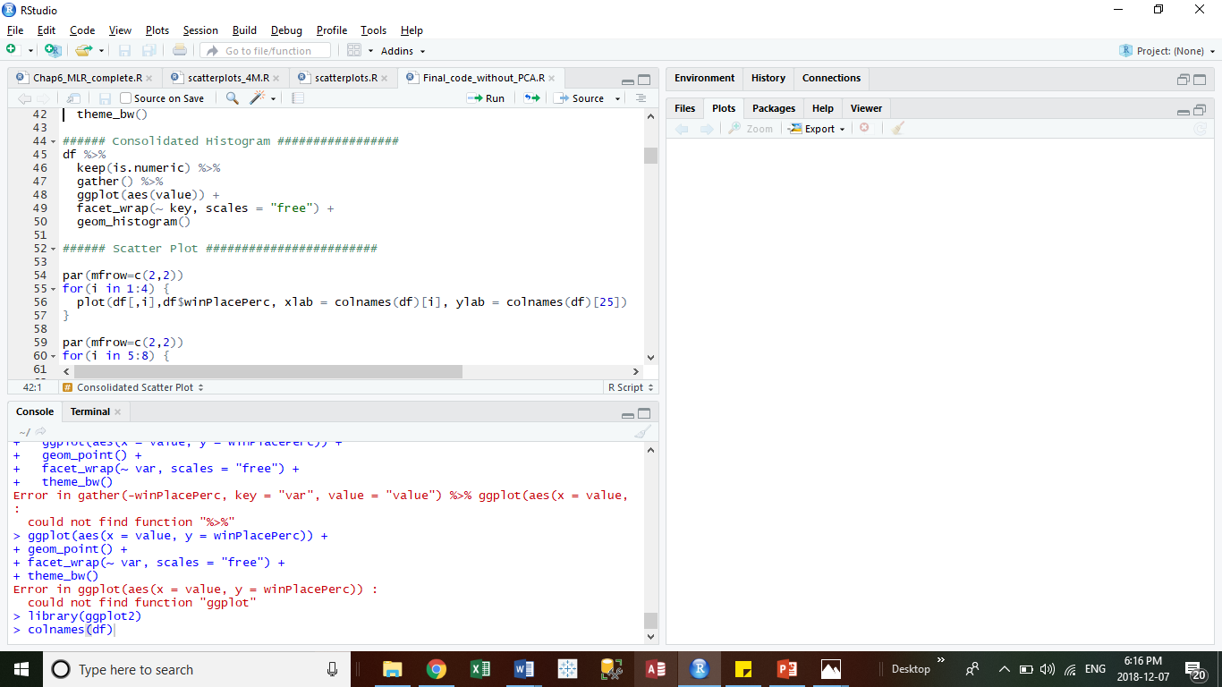
HISTOGRAMS

Slide 12
Data cleaning and preprocessing
Variable Reduction
Data Set | Rows, Columns
After Random Sampling | [100,000, 29]
Based On Domain Knowledge | [100,000, 24]
1
Group ID
Match ID
ID
Matchtype
RoadKills

Slide 13
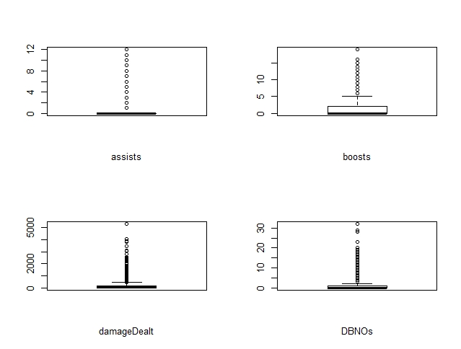
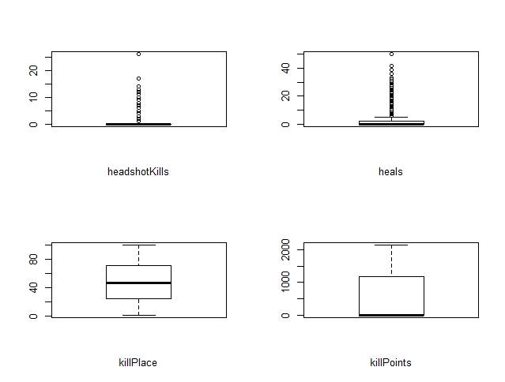
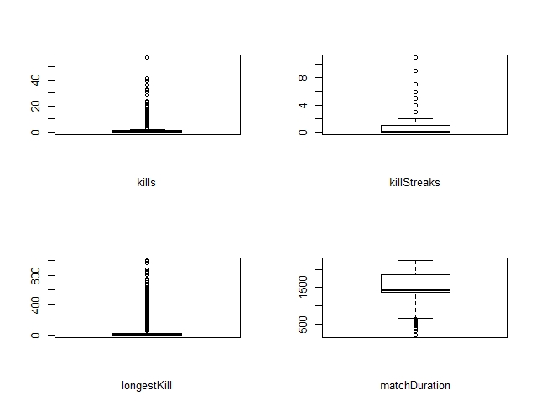
Data cleaning and preprocessing
Outlier Detection: Box Plot
2

Slide 14
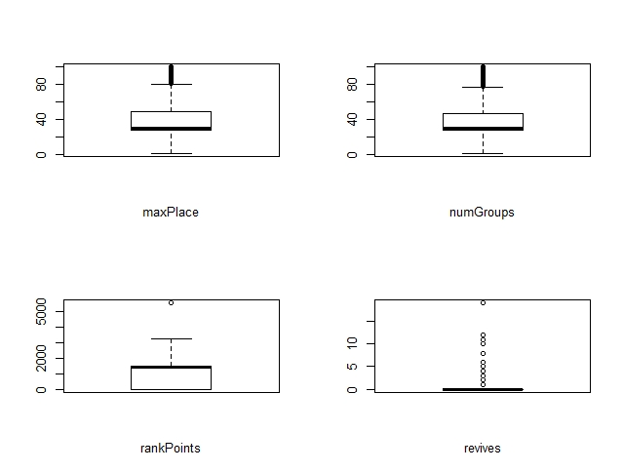
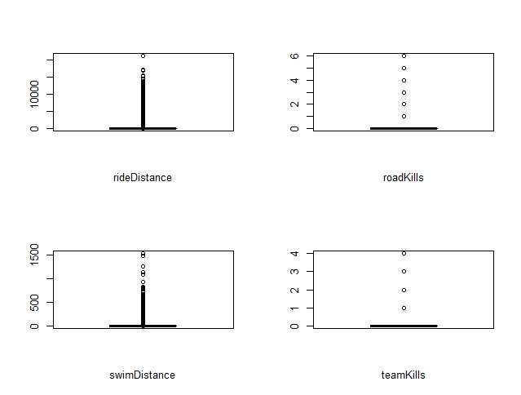
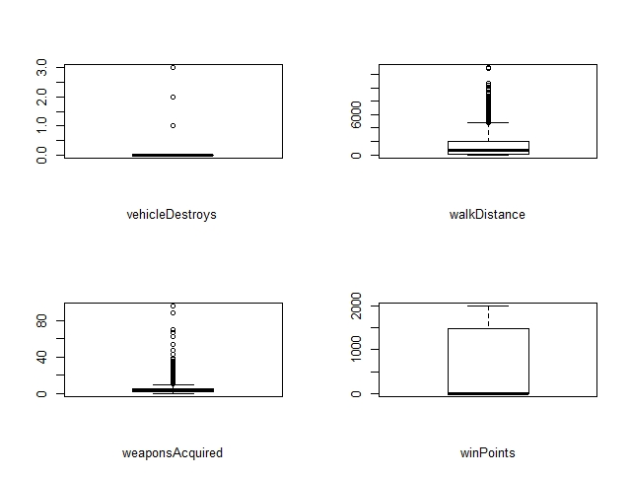
Data cleaning and preprocessing
Outlier Detection: Box Plot

Slide 15
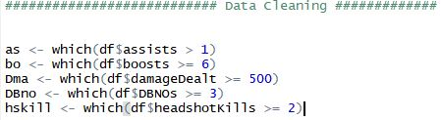
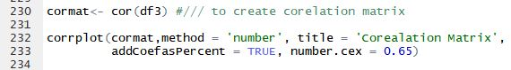
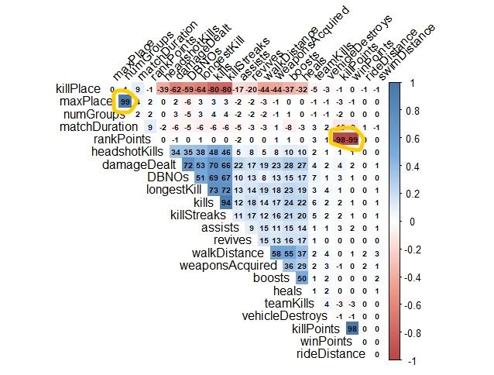
Data cleaning and preprocessing
Outliers Handled
3
[47044,24]
Correlation Matrix
4
Cutoff Value: 0.90
5
MaxPlace, Numgroup | 99
Killpoints, Rankpoints | -98
Winpoints, Rankpoints | -99
[47044,21]

Slide 16
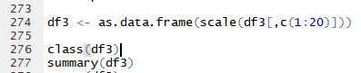
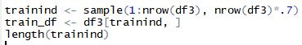
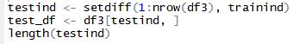
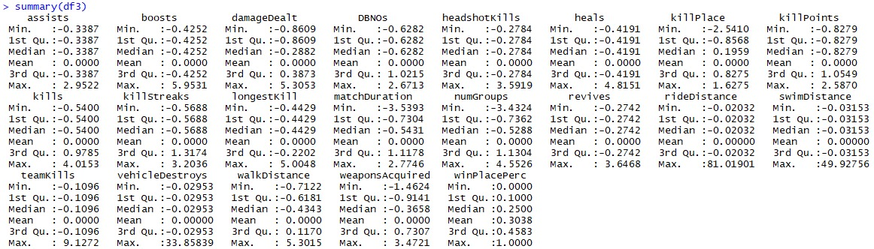
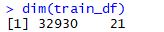
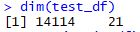
Data cleaning and preprocessing
6
Normalization
7
Partitioning Data Set
70% Training Dataset
30% Test Dataset
On all variables except Output variable

Slide 17
Method implementations
MLR – Multiple Linear Regression
CART – Classification and Regression Tree
kNN – k Nearest Neighbours

Slide 18
Multiple linear regression
Predict the value of the dependent variable winPlacePerc based on predictors kills, DBNOs, assists, boosts etc.
Regression coefficients β_{1,} β_{2,…,} β_{p} In the equation and they are calculated using ordinary least squares (ols).
Y = β₀+β₁X₁ + β₂X₂ + …..+ β_{p}X_{p} + error

Slide 19
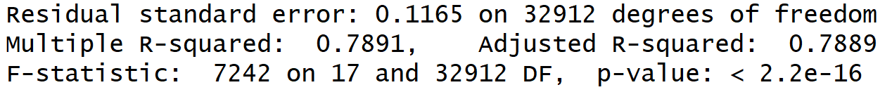
Multiple Linear Regression
Variable selection methods
Forward selection
lm(formula = winPlacePerc ~ walkDistance + killPlace + killStreaks + numGroups + matchDuration + kills + boosts + weaponsAcquired + assists + DBNOs + heals + revives + killPoints + longestKill + headshotKills + damageDealt + swimDistance, data = train_df)

Slide 20
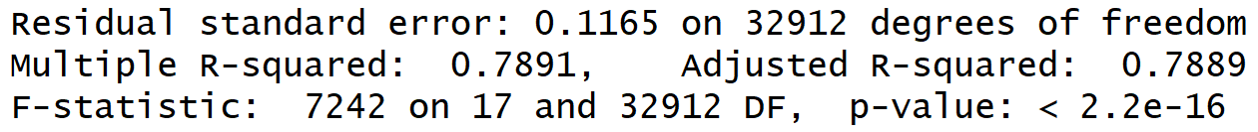
Multiple Linear Regression
Variable selection methods
Backward selection
lm(formula = winPlacePerc ~ assists + boosts + damageDealt + DBNOs + headshotKills + heals + killPlace + killPoints + kills + killStreaks + longestKill + matchDuration + numGroups + revives + swimDistance + walkDistance + weaponsAcquired, data = train_df)

Slide 21
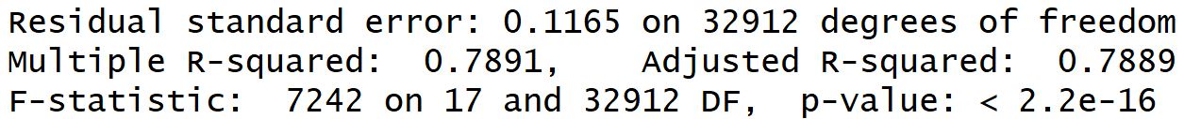
Multiple Linear Regression
Variable selection methods
Stepwise selection
lm(formula = winPlacePerc ~ walkDistance + killPlace + killStreaks + numGroups + matchDuration + kills + boosts + weaponsAcquired + assists + DBNOs + heals + revives + killPoints + longestKill + headshotKills + damageDealt + swimDistance, data = train_df)

Slide 22
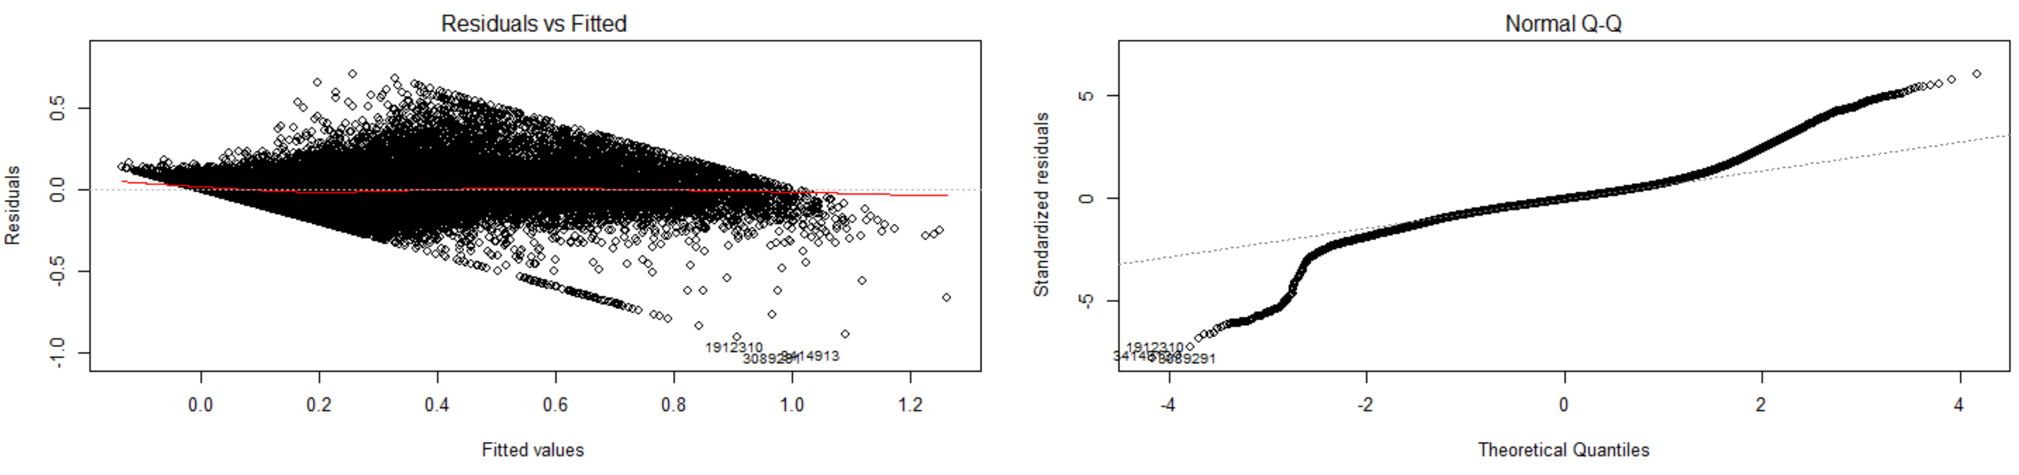
Multiple linear regression
Assumptions
Normality
The residuals (errors) should be normally
Distributed about the predicted
Responses.
Two common methods to check this assumption include using: (a) a histogram (with a superimposed normal curve) and a Normal P-P Plot; or (b) a Normal Q-Q Plot of the studentized residuals.

Slide 23
Multiple linear regression
Assumptions
Linearity
Linear relationship between the outcome variable and the independent variables.
Scatterplots can show whether there is a linear or curvilinear relationship

Slide 24
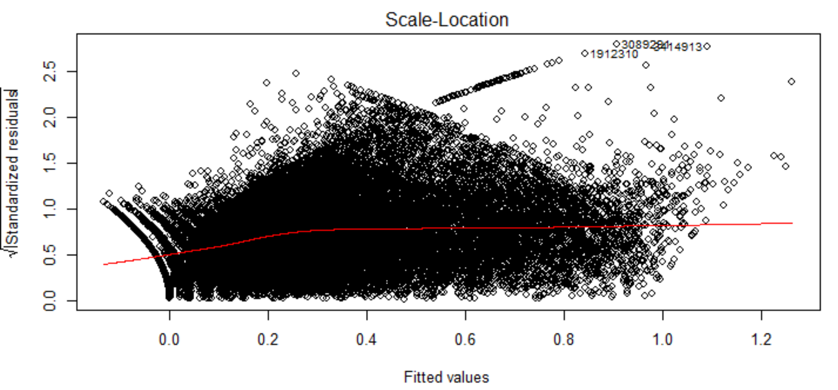
Multiple linear regression
Assumptions
Independence
All predictors must be independent of each other.
Homoscedasticity
Plot of standardized residuals versus predicted values can show whether points are equally distributed across all values of the independent variables.

Slide 25
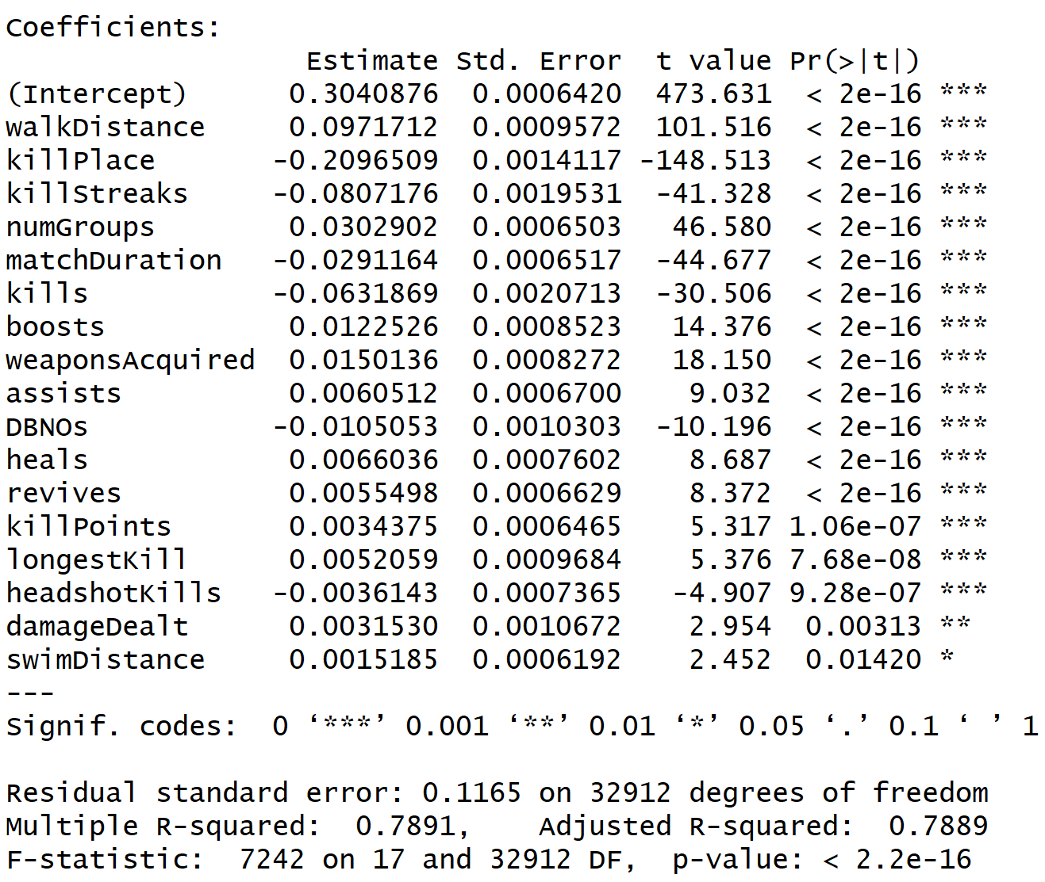
Multiple linear regression
Results
yhat = predict(obj_fwd, newdata=test_df[,])
ytest = test_df$winPlacePerc
rmse(ytest, yhat)
[1] 0.1163719 → rmsE

Slide 26
Regression Tree
Predicted Rating
If killPlace value lies between 0.66 and 0.99, then the winning percentage will be 0.13
Decision nodes with variable importance
Walkdistance: 43
Killplace: 20
Longestkill: 4
Numgroups: 1

Slide 27
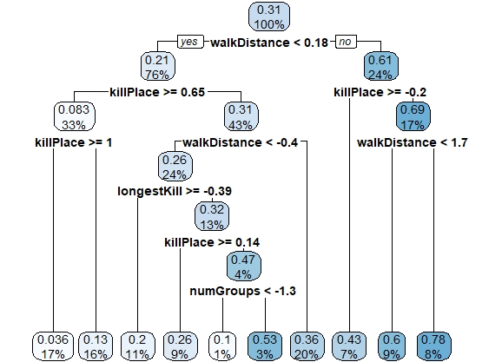
Regression tree
Best Pruned Tree
RMSE: 0.1278694

Slide 28
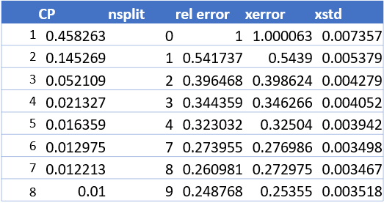
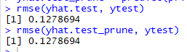
Regression tree
Output:

Slide 29
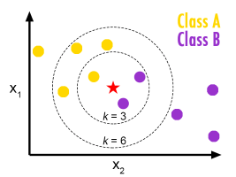
KNN – K NEAREST NEIGHBORS
Notes:
KNN relies on finding “similar records” in training data to predict a new record.
In our case we will be predicting the ‘WinPlacepercentile’ value by using KNN method with the help of the 20 independent variables.
K-nearest neighbors method identifies the k records in the training dataset that are similar to a new record that we wish to classify
We will be selecting the optimal K given to us by the R code that we ran, which will be used further for the prediction

Slide 30
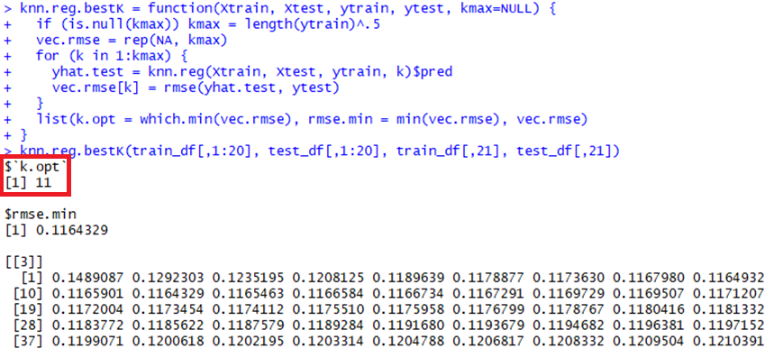
KNN – K NEAREST NEIGHBORS
Optimum K
Notes:
We have used professor’s KNN function
In the first line we have passed kmax as NULL
kmax - squareroot of the number of records (here we have passed it with length of winplaceperc in training data)
This formula when used with the training and test data, we are able to get the k-optimum value with it’s rmse value which is the lowest among all the rmse values which are displayed in the output
Xtrain and xtest will be the independent variable data for training and test data whereas the ytrain and ytest would be the dependent variable data

Slide 31
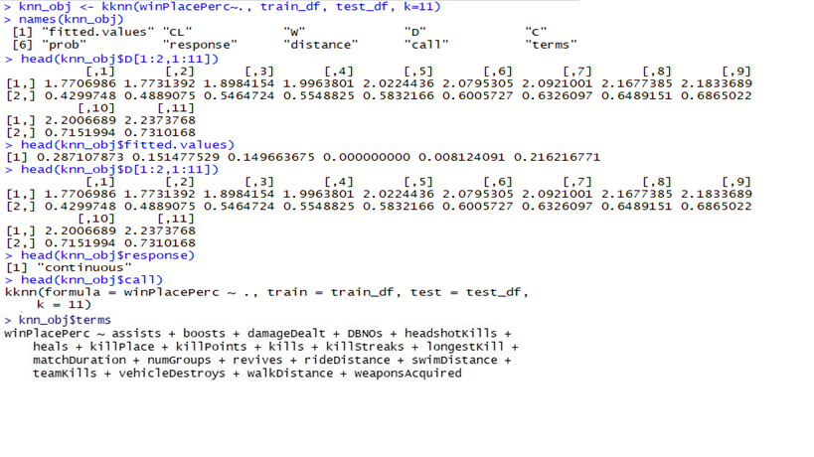
KNN – K NEAREST NEIGHBORS
kNN objects
Notes:
Distance used by R in the kknn function is Minkowski distance which is a generalization of Euclidean and Manhattan distance
Kknn is used to perform the classification of test set using training set, in this function we have passed the k value as 11
Names function is used to get the names of the object, what all are stored for this object
names() function will show you everything that is stored in R under knn_obj object name
fitted.values - Vector of predictions
CL - Matrix of classes of the k nearest neighbors
W - Matrix of weights of the k nearest neighbors
D - Matrix of distances of the k nearest neighbors
C - Matrix of indices of the k nearest neighbors.
prob - Matrix of predicted class probabilities.
response - Type of response variable, one of continuous, nominal or ordinal
distance - Parameter of Minkowski distance.
call - The matched call
terms - The 'terms' object used.

Slide 32
analysis
Applied PCA on kill related variables.

Slide 33
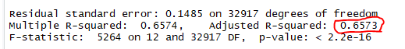
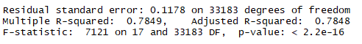
Results
MLR Output with PcA
MLR Output without PcA

Slide 34
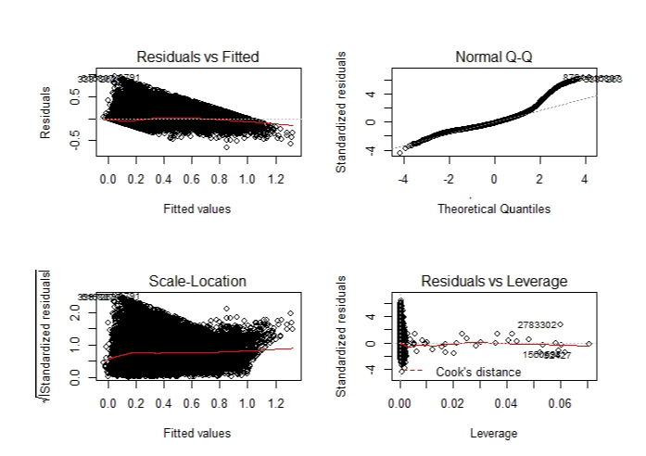
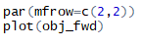
Results
MLR assumptions with PCA

Slide 35
Results
RMSE
 | Without PCA | With PCA
MLR | 0.1162 | 0.1479
CART | 0.1256 | 0.1273
k-NN | 0.1160 | 0.1319

Slide 36
conclusion
Analysis without applying PCA provides the best results for all the three algorithms.
MLR is not an optimal method to predict win place percentile as the assumptions of MLR does not meet in either of the case.
Based on the RMSE value k-NN with k = 11 is the best method to predict the win place percentile variable

Slide 37
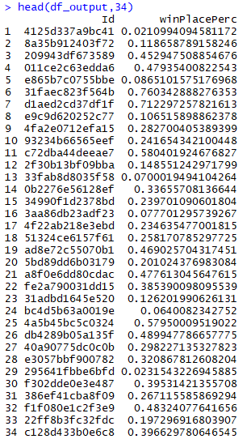
Predicted Output

Slide 38
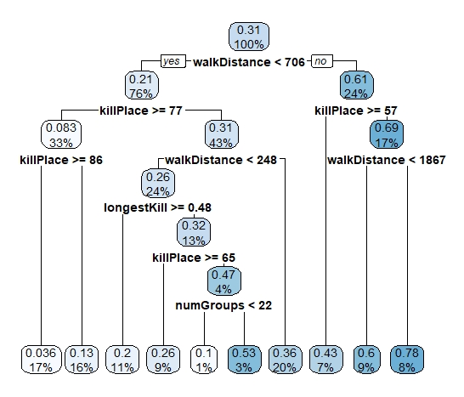
Best Strategy

